Slide 1
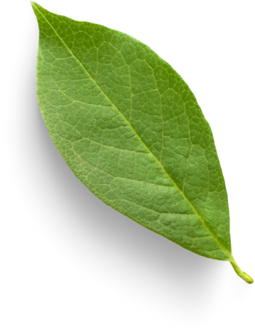


PHYTOPLANKTON AIR SYSTEM
ALGAERITHMS INC.
DHARMIK SHAH
N01581796

Slide 2



PROJECT OVERVIEW
Goal:
To design and build a smart, algae-based air purification system that leverages phytoplankton—microscopic aquatic organisms known for their ability to convert CO₂ into oxygen through photosynthesis., enhanced by sensor-driven real-time monitoring via an Android app.
What it does:
Converts CO₂ to oxygen using phytoplankton
Monitors environment with sensors
Gives users visual + interactive feedback via an Android app
Encourages eco-conscious behavior through gamified features

Slide 3
Software
Android Studio (Java)
Firebase for:
Realtime Database
Notifications
User Authentication
Key features:
Live sensor data (CO₂, temp, humidity)
Alerts + badges for clean air
Customizable notifications + daily summaries
SOFTWARE AND HARDWARE OVERVIEW
Hardware
Raspberry Pi as the microcontroller
Connected to:
CO₂ sensor
Temp/Humidity sensor
Light sensor
Turbidity sensor
Proximity sensor (mine)
Water level sensor (in final version)
Communicates with Firebase over Wi-Fi

Slide 4





YOUR LOGO
CONNECTED
SENSORS
SIMPLIFIED SYSTEM DIAGRAM
COLLECTS DATA AND SENDS IT
FETCHES DATA
DISPLAYS REAL TIME INFO
ANDROID APPLICATION
FIREBASE

Slide 5
SENSORS IN THE SYSTEM
Sensors | Purpose
CO2 Sensor | Core air quality measurement (tracks purification effectiveness)
Light Sensor | Ensures sunlight is sufficient for photosynthesis
Turbidity Sensor | Tracks water clarity (cleanliness of the system)
Proximity Sensor | Detects when someone approaches the system
Water level | Ensures algae tank has enough water (coming soon)

Slide 6
MY SENSOR – VCNL4040 (PROXIMITY + LUX)
PART NUMBER: 1528‑4161‑ND
MODEL: VCNL4040
PROXIMITY: DETECTS OBJECT PRESENCE/MOVEMENT NEARBY
LUX (LIGHT): TRACKS AMBIENT LIGHTING LEVELS
INTERFACE: I²C
POWER USAGE: LOW
FOOTPRINT: COMPACT (IDEAL FOR EMBEDDED SETUPS)

Slide 7

WHY THIS SENSOR?
Combines proximity + ambient light in one chip
No lens needed – works behind plastic or glass
Low power – great for continuous indoor use
Plug-and-play with STEMMA QT – fast to prototype
Helps detect user interaction near the device for triggered animations/alerts in app

Slide 8
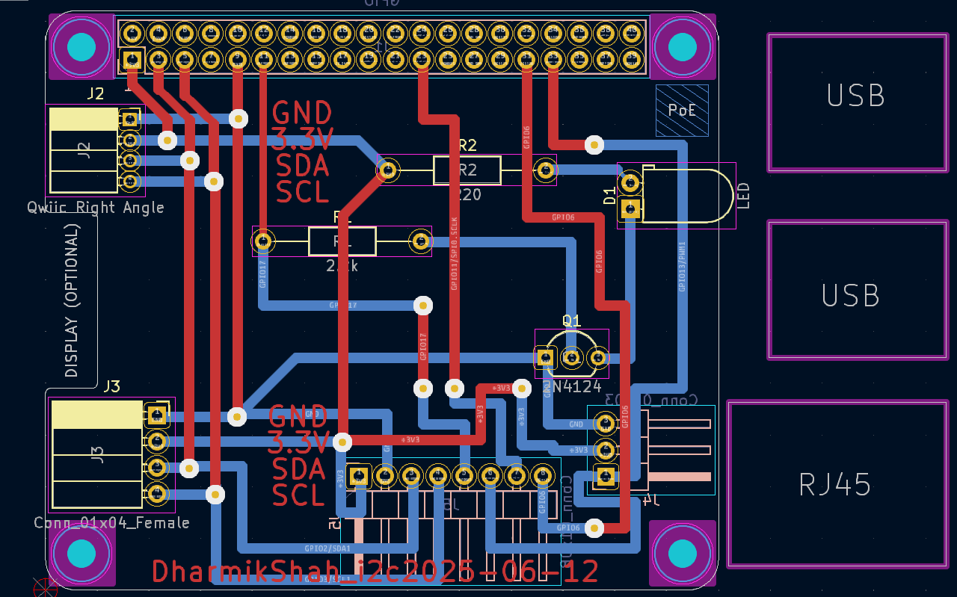
PCB DESIGN

Slide 9
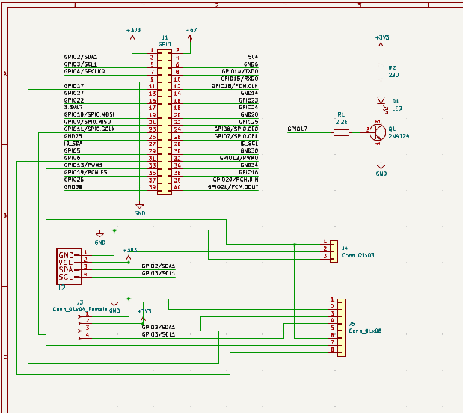
SCHEMATIC

Slide 10
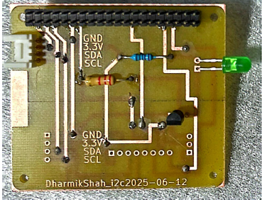
SOLDERED PCB

Slide 11
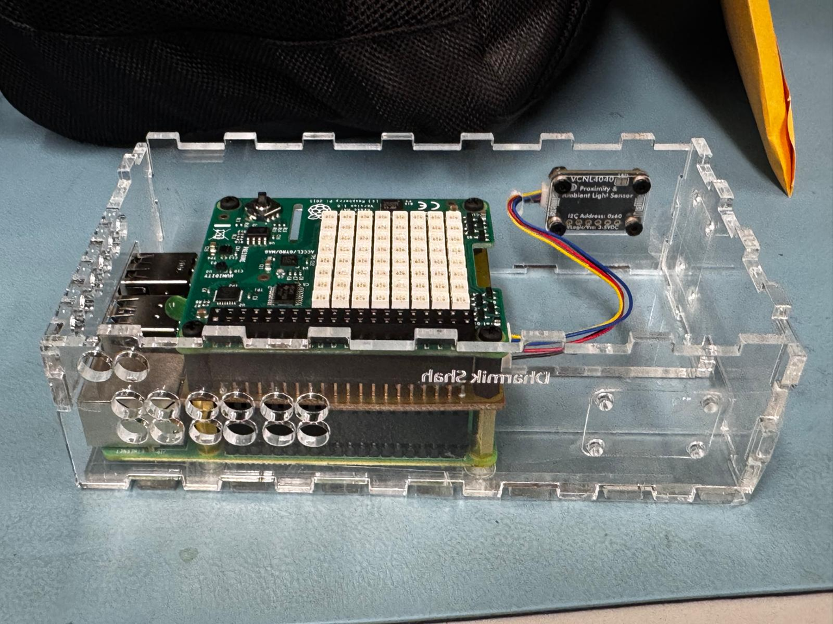
CASE DESGIN

Slide 12
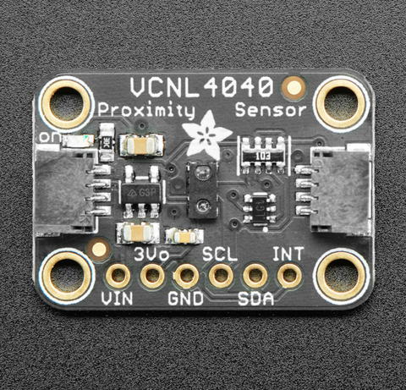
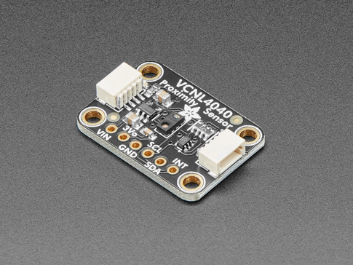
KEY FEATURES OF VCNL4040
Proximity Detection Range: up to ~200mm
Ambient Light Sensing Range: 0.004 to 16,777 lux
I²C Address: 0x60
Infrared emitter built-in
16-bit resolution for both sensors
Fast sampling & low power consumption

Slide 13
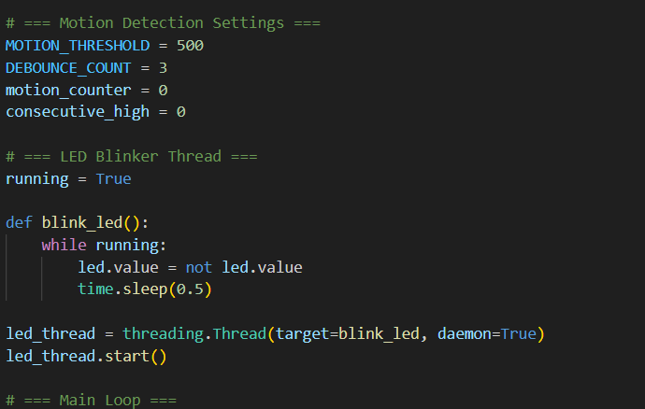
CODE SNIPPET
(MULTITHREADING)

Slide 14
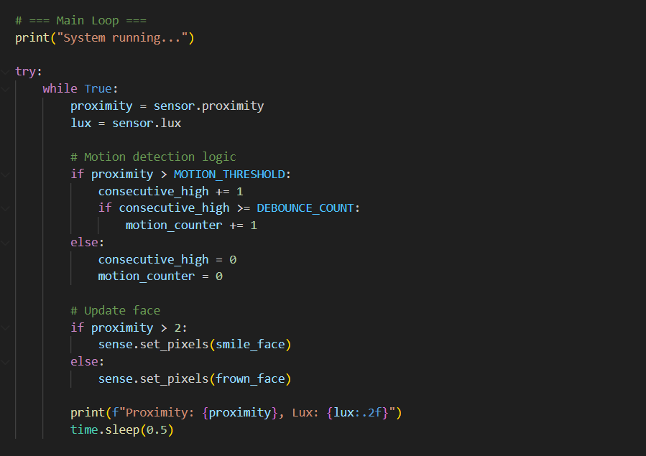
CODE SNIPPET

Slide 15
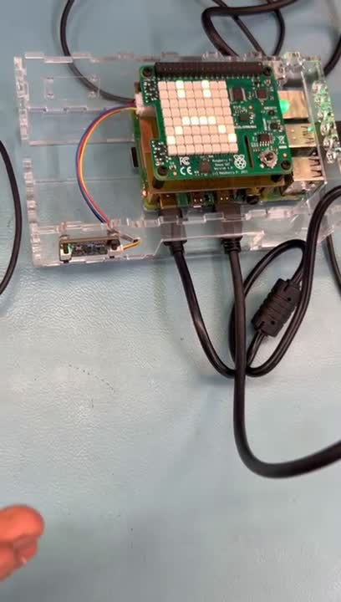
DEMO

Slide 16
CHALLANGES AND SOLUTIONS
KiCad, InkScape: Had to research for it
Had to rush it because the research took too much time and also waited too much for confirmation
Threshold issue for distance - it was super close before (2000), used 500
Making a hole in the design of the case

Slide 17
THANK YOU
FOR YOUR ATTENTION!
DHARMIK SHAH
ALGAERITHMS INC.

